Slide 1
Intro

Slide 2
What are decision trees?

Slide 3
Let's go back to our previous task and dataset
Dataset:
Year
Customer_id - unique id
Phone_no
Gender
Age
No of days subscribed - the number of days since the subscription
Multi screen - does the customer have a single/ multiple screen subscription
Mail subscription - customer receive mails or not
Weekly mins watched - number of minutes watched weekly
Minimum daily mins - minimum minutes watched
Maximum daily mins - maximum minutes watched
Weekly nights max mins - number of minutes watched at night time
Videos watched - total number of videos watched
Maximum_days_inactive - days since inactive
Customer support calls - number of customer support calls
Churn -
1- Yes
0 - No
Task:
XYZ is a service providing company that provides customers with a one year subscription plan for their product.
The company wants to know if the customers will renew the subscription for the coming year or not.

Slide 4
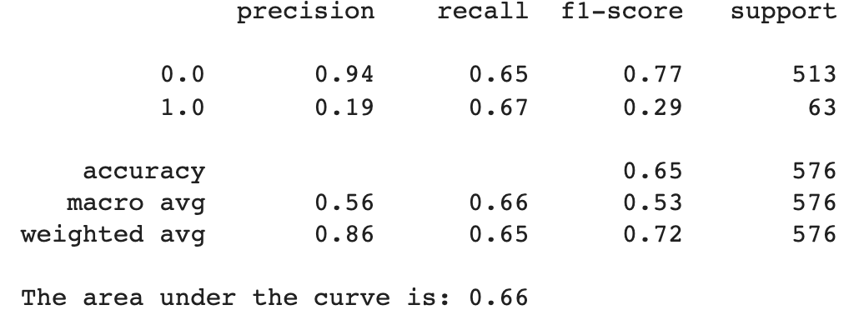
Logistic regression only took us thus far

Slide 5
We can use Decision Trees to think about this problem!

Slide 6
What are decision trees?
Root
Is multi-screen?
Leaf
Node
Yes
No
Not Churn
Minutes watched > 60?
Yes
No
Leaf
Leaf
Not Churn
Churn

Slide 7
Video 2

Slide 8
In an ideal world….
In a real world…
?

Slide 9
Measure of impurity
allows us to identify how clean a node is

Slide 10

Gini Index
1 - minus the squared frequentist probability of each class
0: perfect equality
1: perfect inequality
GiniNode = 1 - (⅜ )^2 - (⅝ )^2 = 0.87
GiniSplit = (4*0.5 + 4*0.35)/8 = 0.42
GiniChild = 1 - (½ )^2 - (½ )^2 = 0.5
GiniChild = 1 - (¼ )^2 - (¾ )^2 = 0.35

Slide 11
How does it work

Slide 12
For each feature:
Calculate the Gini Index of the Node and each leaf
Calculate the Gini of the split (weighted average of Gini of each leaf)
GiniNode = 1 - (⅜ )^2 - (⅝ )^2 = 0.87
GiniSplit = (4*0.5 + 4*0.35)/8 = 0.42
If Gini of split < Gini of Node, then split - Else don’t split
GiniChild = 1 - (½ )^2 - (½ )^2 = 0.5
Chose to split on the feature that does the 'best possible split'
Max Gini Gain = Gini Node - Gini of the Split
GiniChild = 1 - (¼ )^2 - (¾ )^2 = 0.35

Slide 13
Making the split for categorical x continuous/discrete variables
Yes
10
Is Multi Screen?
Minutes watched
11
…
No
200

Slide 14
Types of Decision trees

Slide 15
CART x C5.0 x CHAID
These and other different algorithms for decision trees change the measure of impurity and how they make the split:
CART:
Measure of Impurity: Gini Index
C5.0:
‘Measure of Impurity’: Entropy
CHAID:
Cannot handle continuous variables - must transform them in deciles before
Produces more than 2 splits - if required
Split with Chi-Square Statistics

Slide 16
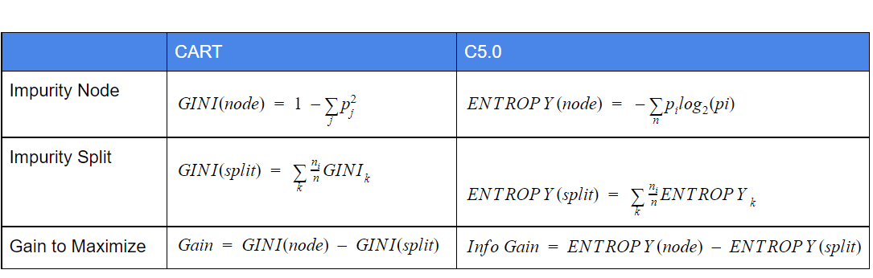
CART x C5.0
Notes:
Entropy

Slide 17

C5.0
0: lowest entropy - lowest variability or ‘suprise’
1: highest entropy - highest variability or ‘suprise’
EntropyNode= -(⅜ )log2(⅜ ) - (⅝ )log2(⅝ ) = 0.95
Entropy= (4*1 + 4*0.81)/8 = 0.90
EntropyChild= -(½ )log2 (½ ) - (½)log2(½) = 1
EntropyChild= -(¼ )log2 (¼ ) - (¾)log2(¾) = 0.81

Slide 18

CHAID
Oldest Decision Tree Algorithm
Can only be used with categorical independent variables (can be more than 1 category, but they need to be categorical)
Because of this limitation in itself it has been replaced by C5.0 and other tree algorithms
EntropyNode= -(⅜ )log2(⅜ ) - (⅝ )log2(⅝ ) = 0.95
Entropy= (4*1 + 4*0.81)/8 = 0.90
EntropyChild= -(½ )log2 (½ ) - (½)log2(½) = 1
EntropyChild= -(¼ )log2 (¼ ) - (¾)log2(¾) = 0.81

Slide 19
CHAID
Oldest Decision Tree Algorithm
Can only be used with categorical independent variables (can be more than 1 category, but they need to be categorical)
Because of this limitation in itself it has been replaced by C5.0 and other tree algorithms
The highest the Chi-Squared, the lowest the correlation between the independent and dependent variable
Iterate through all the variables and find the ones that are the least correlated to make the first split
Repeat step after a split is made
If at any point the split found is not statistically significant, ignore this category (merging with the previous ones)

Slide 20
Video 5 - Scikit Learn Implementation

Slide 21
Feature Importance

Slide 22
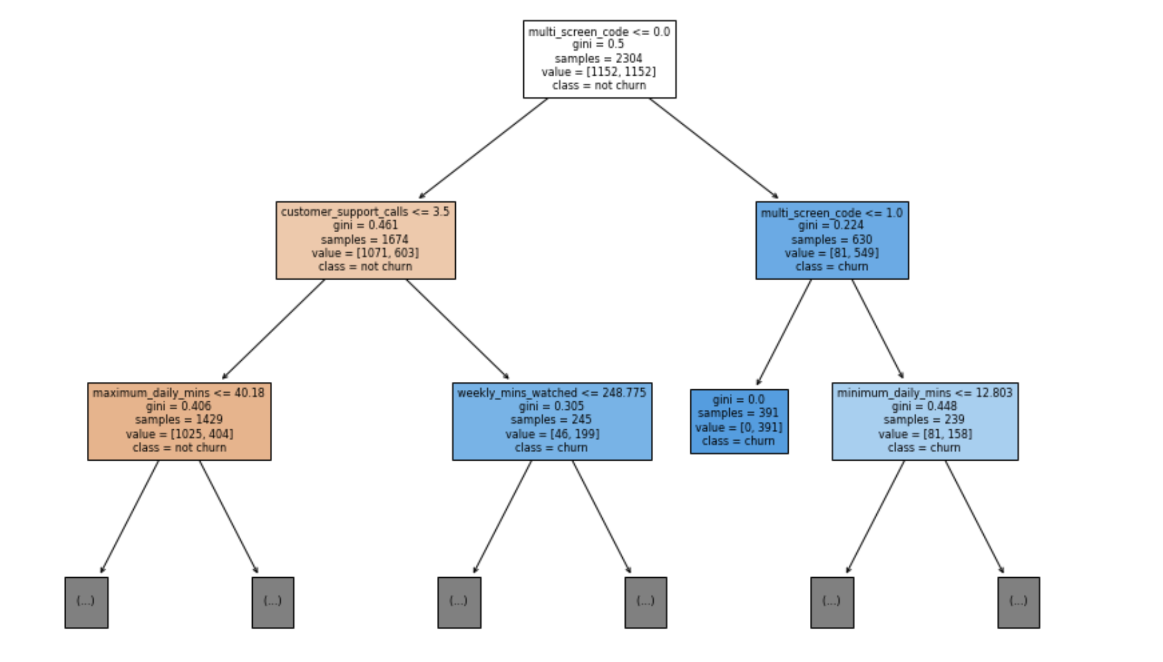
It is not easy to represent decision trees…
A useful way to get some high-level insight into the structure of the tree is to think about feature importance
Which feature was most important to split all these different nodes?
Feature importance -> Proportional to the capacity of each feature to decrease the impurity in the nodes

Slide 23

Feature Importance
Decrease in node impurity weighted by the proportion of samples on a given node
Proportion of samples on each node
Importance of feature f
Gini gain on the node
Sum across all nodes that split on f

Slide 24
Video 7 - Feature Importances Scikit Learn

